Slide 1

Fake News Detection
BMS College of Engineering
Department of Information Science and Engineering
P Aishwarya Naidu (1BM16IS062)
Pooja Chadha (1BM16IS064)
Satvik Vats (1BM16IS079)

Slide 2
Problem Identification
Intentionally deceptive content presented under the appearance of legitimate journalism (or fake news) is a worldwide information accuracy and integrity problem that affects opinion forming, decision making, and voting patterns.
Fake news influences people in multiple ways:
Ability to shape regional and national dialogue
Harmed businesses and individuals
Leads to hoaxes

Slide 4
Objectives
Using linguistic cues to develop a machine learning based model for accurately determining authenticity of the given news.
Demonstrate successful use of classification algorithms to classify the feature vector generated from dataset into real or fake.
To get high accuracy to determine a news is fake or true.

Slide 5
LITERATURE SURVEY

Slide 6
Automatic Detection of Fake News
Veronica et al. have proposed a method for automatic identification of fake news.
They obtained two new fake news datasets, one obtained through crowdsourcing and covering six news domains, and another one obtained from web covering celebrities.
Classification models were developed based on combination of lexical, syntactic, semantic information and readability properties.
They perform cross domain analyses by combining training and testing domains.
The model achieved an accuracy of up to 78%

Slide 8
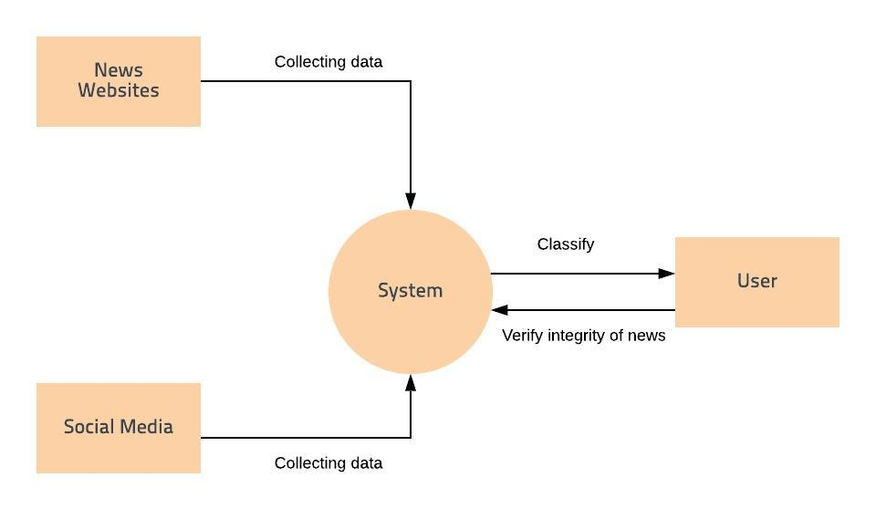
System Design
DFD Level 0

Slide 9
DFD Level 1

Slide 10
DFD Level 2

Slide 11
Technology Stack
Jupyter Notebook
Python 3.7.4
pandas 0.25.1
NumPy 1.17
sklearn 0.19.2
Matplotlib 3.1.1
keras

Slide 12
System Design
Data Preparation –
In all the datasets, unrequired columns were eliminated and labels were specified uniformly.
All the datasets were combined to form the main dataset that will be used for training.
Data Preprocessing –
Dropping duplicates data points.
Placing a threshold on the length of the articles ( > 10 characters )
Dropping any null valued data points, if present.

Slide 13
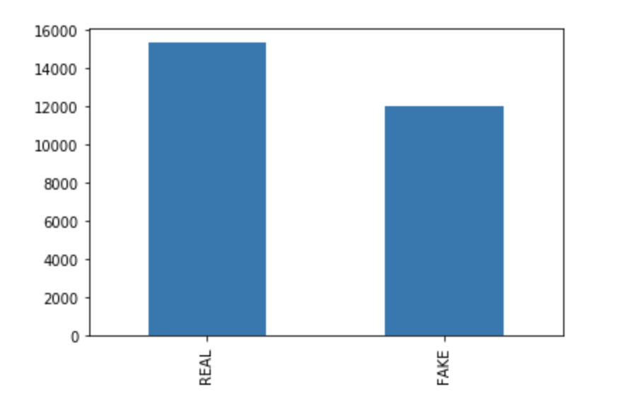
Real - 15343
Fake - 12013
Total - 27356

Slide 14
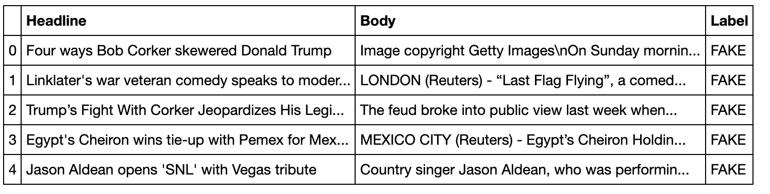

Slide 15
Cleaning Text
Removing punctuation from the text
Conversion to lower case
Removing stop words such as ‘a’ ‘the’ ‘and’ etc
Removing all non English characters
Lemmatizing – Reduces the inflected word to its base dictionary form.

Slide 16
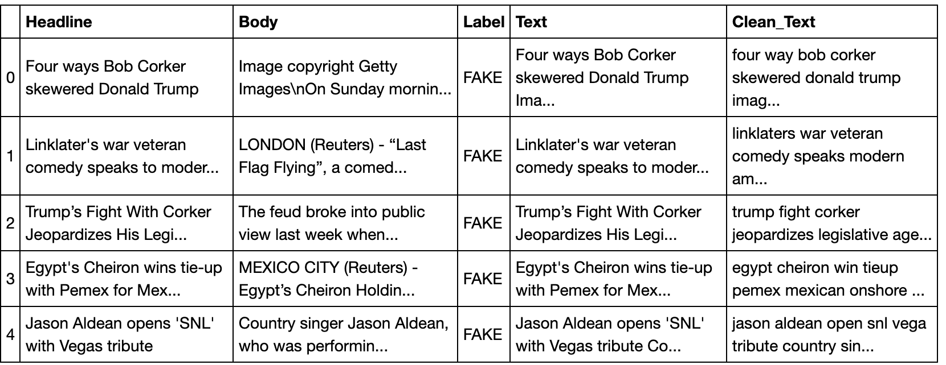

Slide 17
Generating Feature Vectors

Slide 18
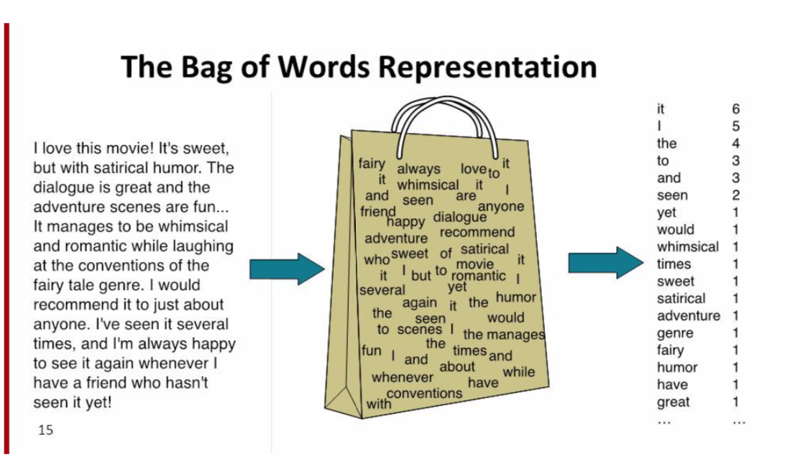
Bags of Words
Bag of words is a way of representing text in a format which can be easily processed by the machine learning algorithms.

Slide 19
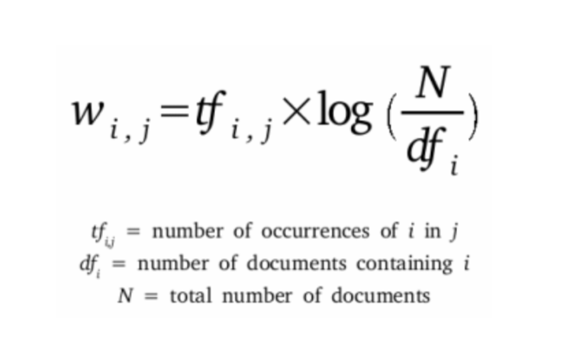
TFIDF
TF-IDF stands for term frequency-inverse document frequency.
It is a numerical statistic that shows how important a word is to a document in a word corpus.

Slide 20
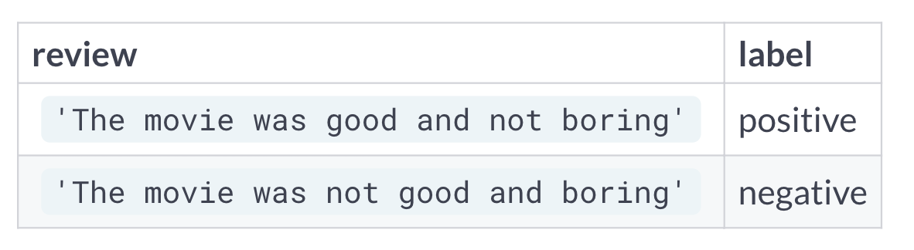
BoW shortcomings
Unigram analysis of text can mislead us.
Exactly same BoW representation. Context of the words is lost.

Slide 21
1. Bigrams
n-gram is a contiguous sequence of n terms from a given text.
N = 2 is a "bigram"

Slide 22
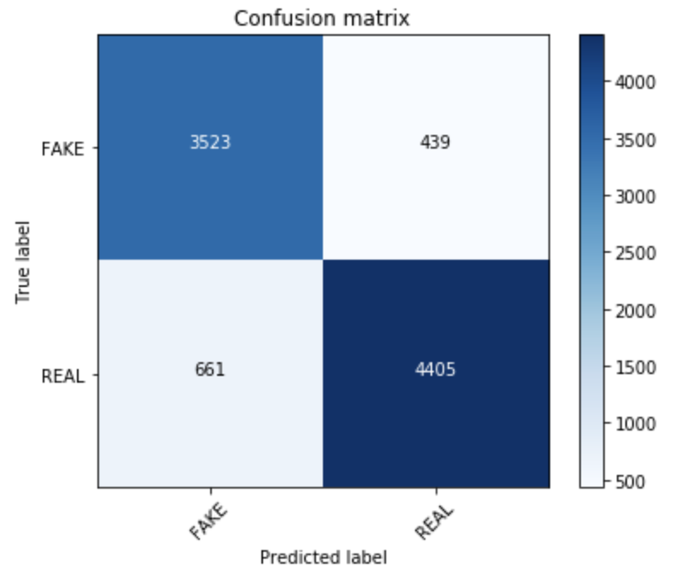
Classification based on Bigrams
Naïve Bayes: 0.87 with alpha level = 0.1
Random Forest: 0.87
Gradient Boost: 0.84

Slide 23
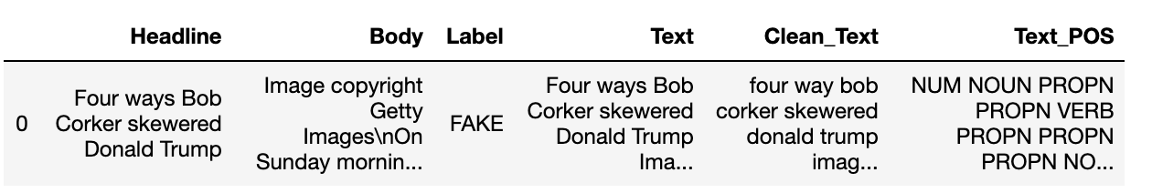
2. Part of Speech (POS) tagging
We generated POS (part-of-speech) tags using the Spacy library.
We generate token using TFIDF and split it into train and test sets.

Slide 24
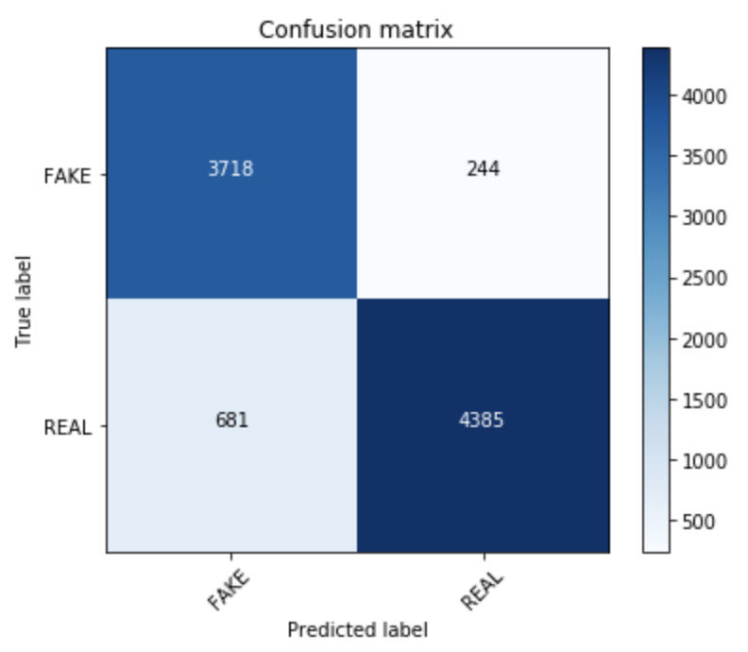
Classification based on POS
Naïve Bayes: 0.66
Random Forest: 0.87
Gradient Boost: 0.89

Slide 25
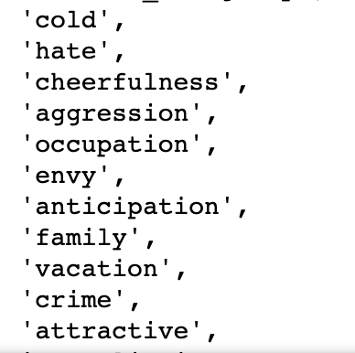
3. Semantic Analysis
A widely used open-source resource for incorporating semantic information is Empath (developed by Stanford).
Empath is a lexicon of words grouped into semantic categories relevant to psychological processes.
Empath has 194 semantic categories, some of these semantic classes are emotional tone( positive or negative), anger, nervousness.

Slide 26
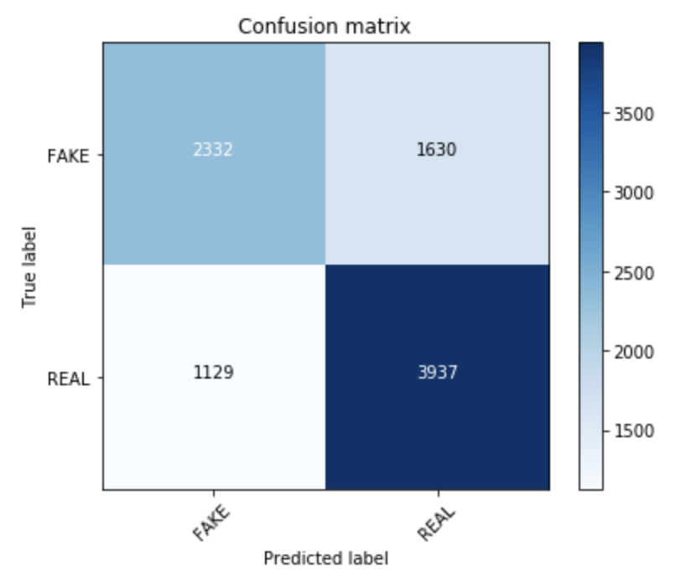
Classification based on Semantic
Naïve Bayes: 0.62
Random Forest: 0.66
Gradient Boost: 0.69

Slide 27
Combination of 3 Features
We considered 3 methods for generating feature vectors:
1. TF-IDF bigram vector of the news article. 2. Feature Vector generated by Syntax Analysis of the news article using Part of Speech (POS). 3. Feature Vector generated by the semantic analysis of the news article for the emotional tone.

Slide 28
We combine these features and from the final news vector on which classification is performed.
We assign weights to each vector and then take the weighted combination of the 3 feature vectors to generate the final vector.

Slide 29
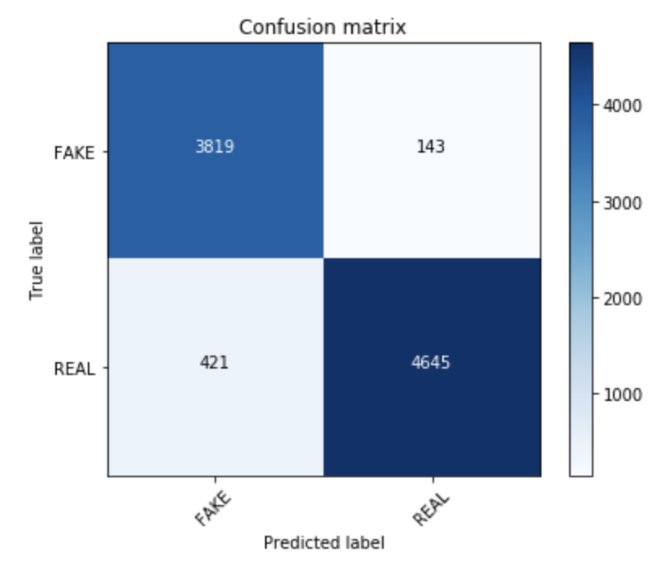
Classification based on all 3
Naïve Bayes: 0.91
Random Forest: 0.89
Gradient Boost: 0.93

Slide 30
THANK YOU

